Slide 1

Our shared vision
Becontree Primary School: A Centre of Excellence in the Local Community
At Becontree Primary School we have high expectations of all members of our school community. We value the efforts of all and work hard to enable everyone associated with the school to fulfil their potential and contribute positively to their educational experiences.
Our school motto, ‘Respecting One Another’, includes showing respect for ourselves and others.

Slide 2
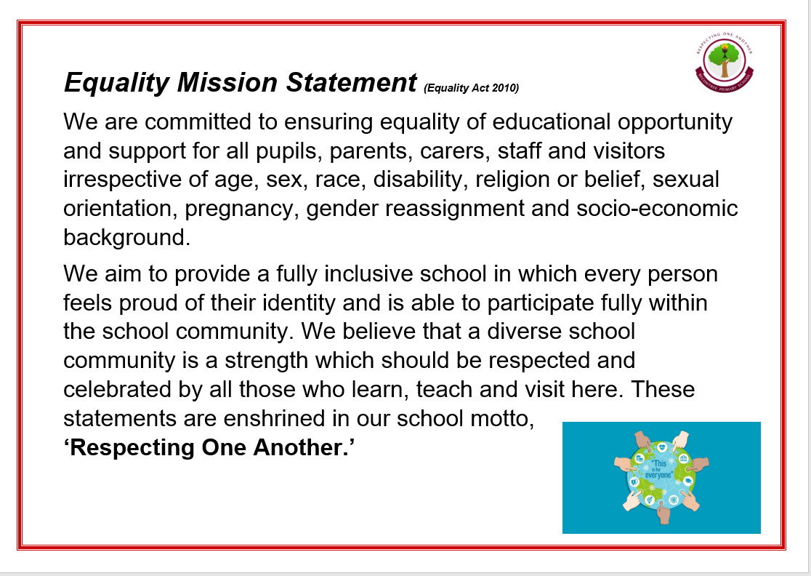

Slide 3

Our Core Purpose
Highly effective teaching and learning within a culture of challenge, nurture and support.

Slide 4
All members of our school community are…
Included
Respected
Nurtured
They are encouraged and supported to be….
Safe
Ambitious
Active and Healthy
Achieve and succeed
So that they are able to ….

Slide 5
All members of our school team make a positive contribution to children’s learning by…
Being a positive role model
Having high expectations
Putting children’s needs first
Showing dedication and commitment
Being enthusiastic
Contributing effectively to our work as a team

Slide 6
Children at Becontree Primary
School love learning. They become…
Effective communicators
Active contributors
Confident and ambitious individuals
Responsible and caring citizens
Successful and independent learners

