Slide 1

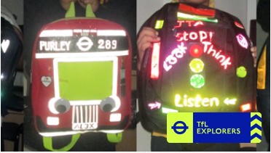
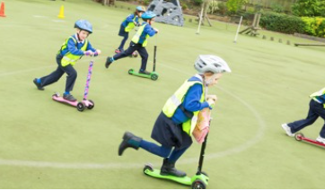
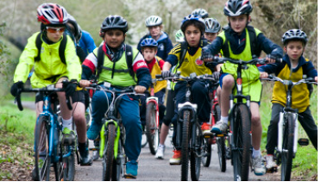
TfL Travel for Life
TfL Explorers Travel Ambassadors

Slide 2
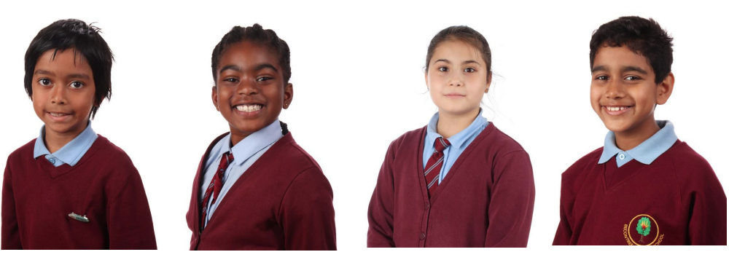
We are a newly formed group called TfL Explorers Travel Ambassadors at Becontree Primary School.

Slide 3
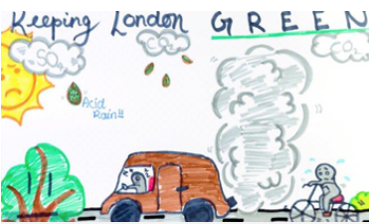
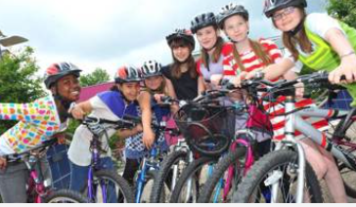
We are going to raise awareness of different issues in school to do with travel, such as road safety, travel skills, improving air quality and health and more as we go on throughout the year.

Slide 4
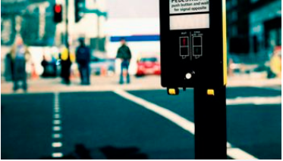
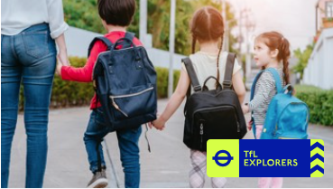
Our first project is to introduce a competition that we would like you to take part in. Listen carefully to see what you have got to do.

Slide 5
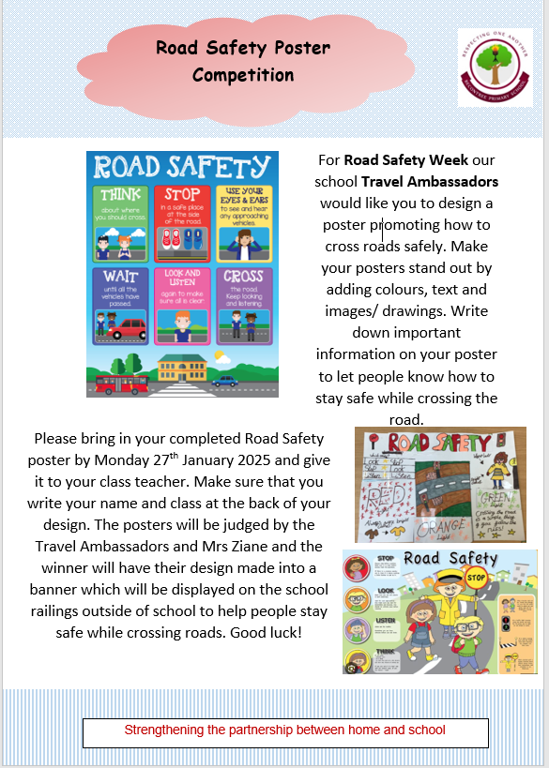
For Road Safety Week we would like you to design a poster promoting how to cross roads safely. Make your poster stand out by adding colours, text and images/ drawings. Write down important information on your poster to let people know how to stay safe while crossing the road.
Please bring in your completed Road Safety poster by Monday 27th January 2025 and give it to your class teacher. Make sure that you write your name and class at the back of your design. The posters will be judged by us and Mrs Ziane. The winner will have their design made into a banner which will be displayed on the school railings outside of school to help people stay safe while crossing roads.
Good luck!

