Slide 1
Multiplication Tables Check(MTC)
Information session

Slide 2
Mrs Wilden
Year 1 and 2 QED lead
Maths lead for EYFS to Year 6

Slide 3


Slide 4
Question this session will answer
What is the MTC?
When is it ?
How is my child supported in school to learn their times tables ?
How can I help my child learn their times tables?

Slide 5
What is the MTC?
The Multiplication Tables Check is a statutory government check for all year 4 pupils.
The purpose of the MTC is to determine whether pupils can recall their times tables fluently, which is essential for future success in mathematics.
Children answer 25 multiplication questions on an Ipad. They have 6 seconds to answer the question before the question disappears and the next one appears.
The questions cover all facts up to 12x12
We normally carry out the check in small groups. First the children use Times tables rock stars to warm up and then they start the check.

Slide 6
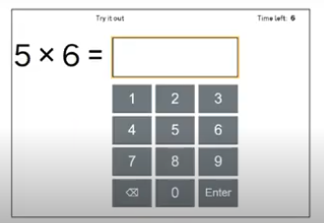
The children answer 3 practice questions which do not count in their score.
When instructed to, they then start the check.
In the weeks running up to the check, the children practice using the Try it out page supplied by the Government.
This allows them to become familiar with the layout of the check.

Slide 7
When is it ?
The check takes place in June. It is spread over two weeks so any children who are absent will still be able to do the check.

Slide 8
How is my child supported in school to learn their times tables ?
Times tables are built into our maths curriculum
We have a half termly Becontree Times Tables challenge competition across the school. Children receive certificates for this.
After lunch time the children complete times tables questions while the teacher is calling the register.
Home learning expectation – Children should be using Times tables Rock
stars (TTRS) at least 3 times a week for at least 10 minutes. Sound Check
- Weekly TTRS competition across the school

Slide 9
We hold mock tests throughout the year
You will be send a letter letting you know the score your child achieved.
Children who are struggling to improve, will be asked to attend a lunchtime
Club. This involves them coming into the year 4 classroom before or after
having there lunch( depending on the rota) and completing 10 minutes of
TTRS. The teacher will ask them to complete either a Sound Check or Jamming.

Slide 10
How can I help my child learn their times tables?
Reward and praise the use of TTRS at home.
Skip count together in the car, on the walk to school e.g. 7,14,21…
Play tables tennis – You say 6, they say 12, you say 18, they say 24
If your child is really struggling, let them use the times tables sheet we have given them to support their recall.
Also, practice 2 or 3 facts e.g. 3,6,9. Once they have remembered those, add one more e.g. 3,6,9,12

Slide 11
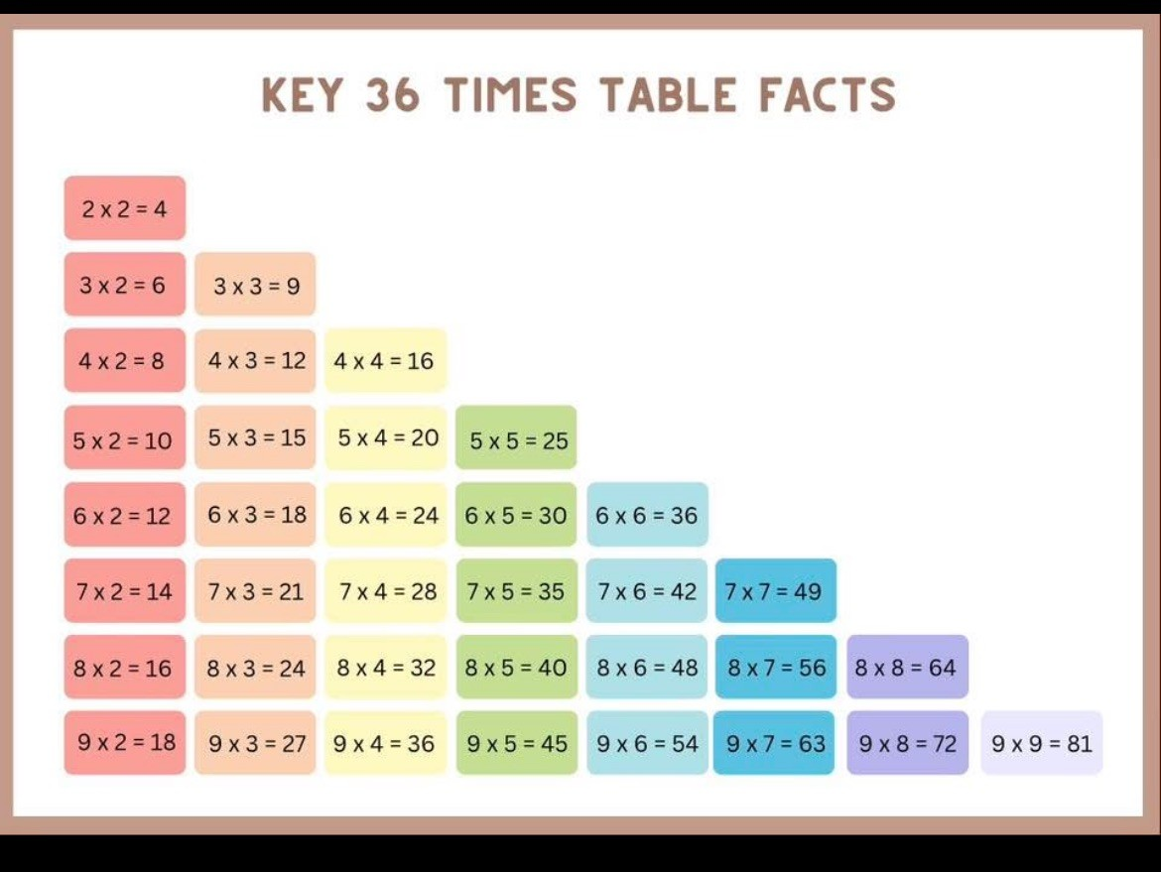
Your child will be given this sheet as well as a sheet with all the times tables facts.
If they can recall these facts they will stand a better chance of scoring well.
*commutativity

Slide 12
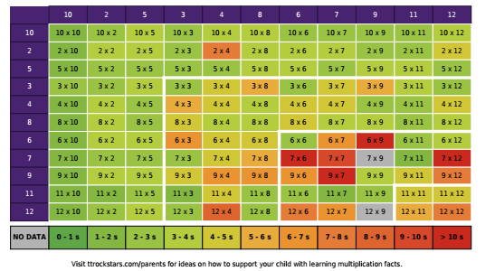

Slide 13
Other websites
Maths Frame
https://mathsframe.co.uk/
Timestables.com
https://www.timestables.co.uk/
Topmarks.co.uk
https://www.topmarks.co.uk/maths-games/7-11-years/times-tables

Slide 14

Any questions?

