Slide 1
My Letters and Sounds
Phase 2
Week 1
s a t p

Slide 2

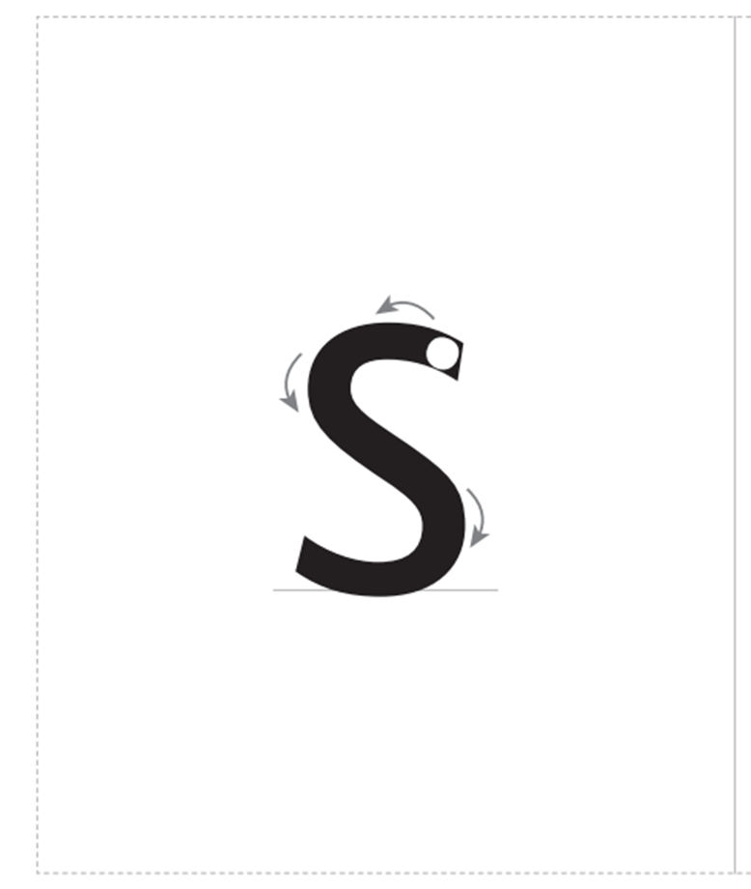

Slide 3
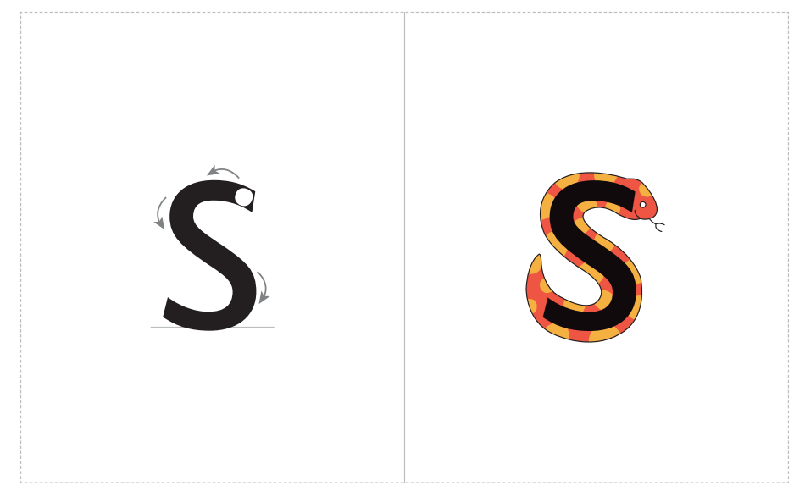

Slide 4
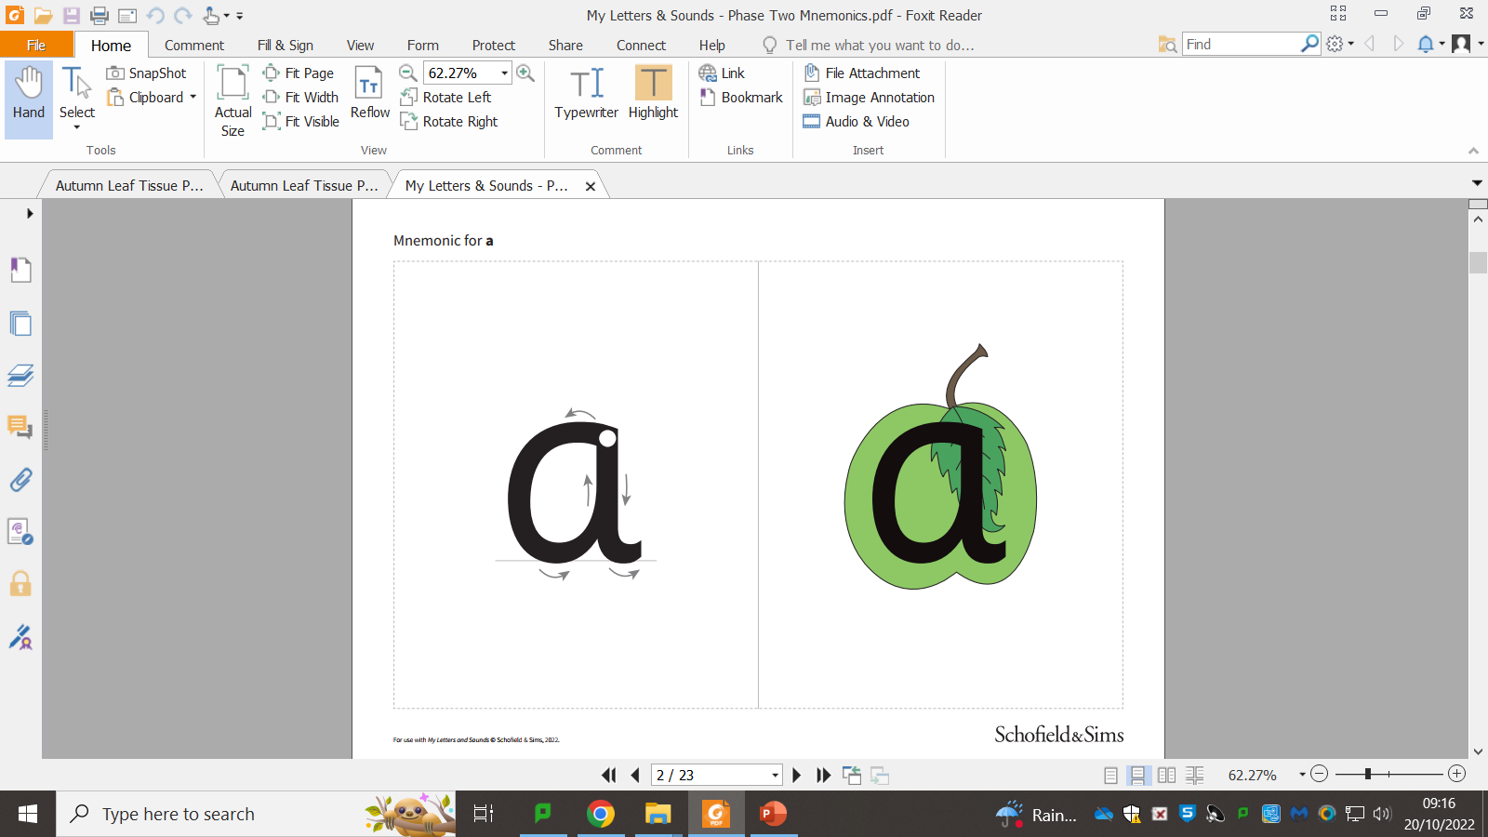

Slide 6
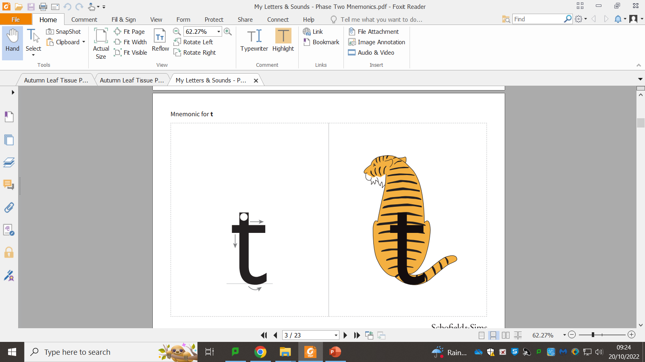

Slide 8


