Slide 1
My Letters and Sounds
Phase 2
Week 2
i m n d

Slide 2

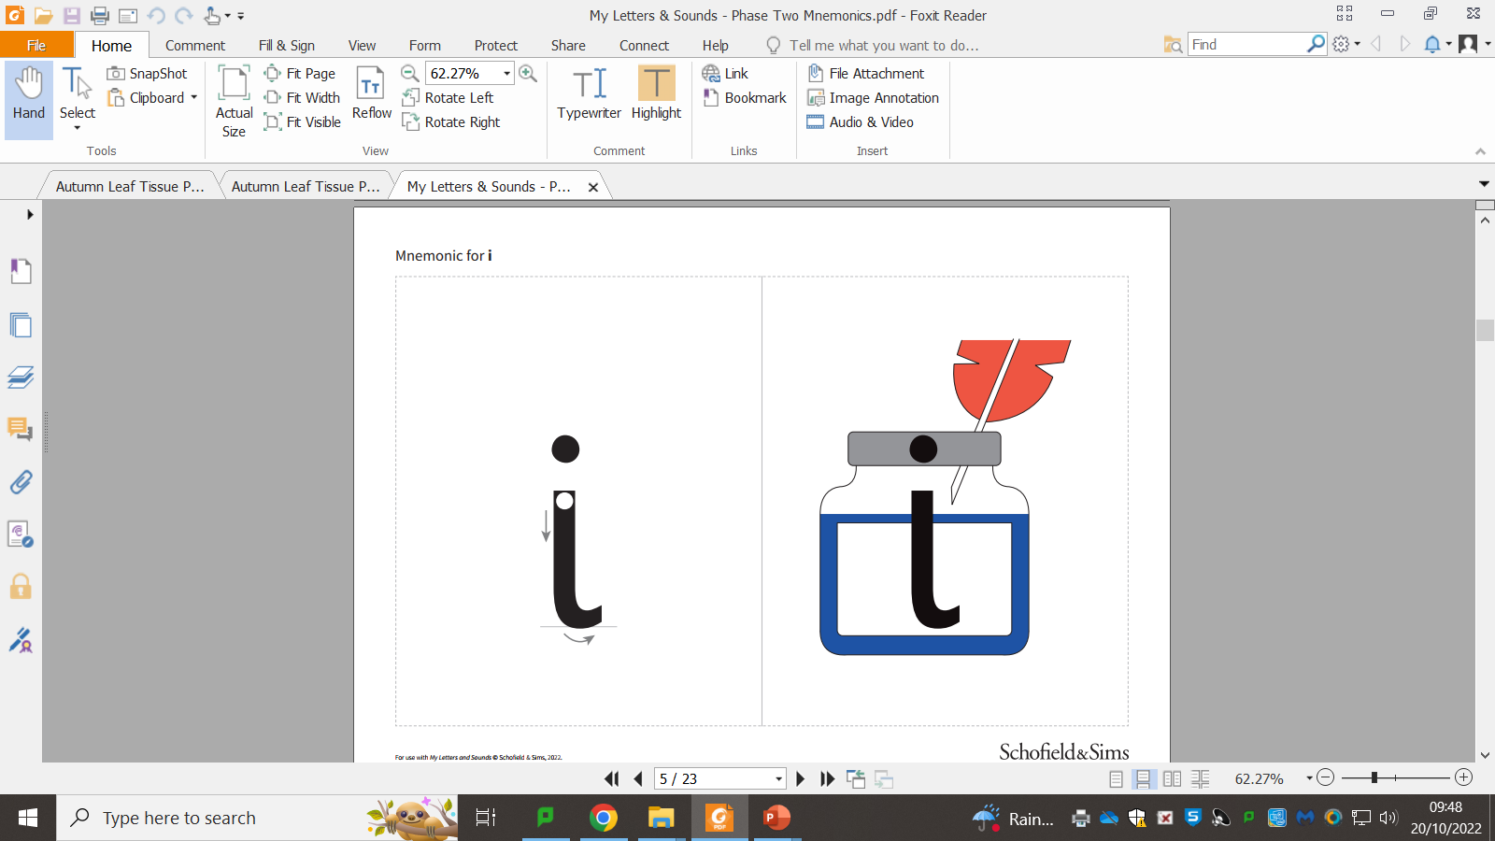

Slide 4
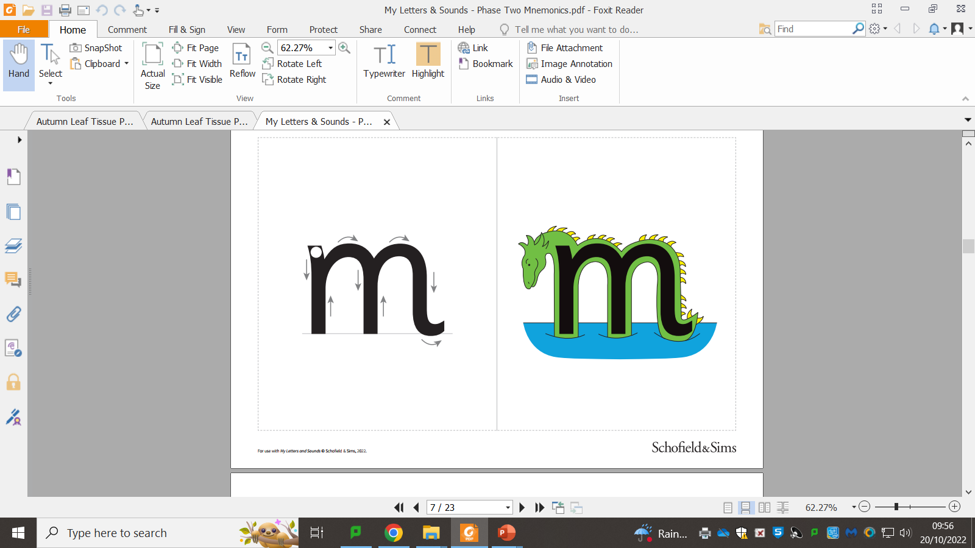

Slide 6
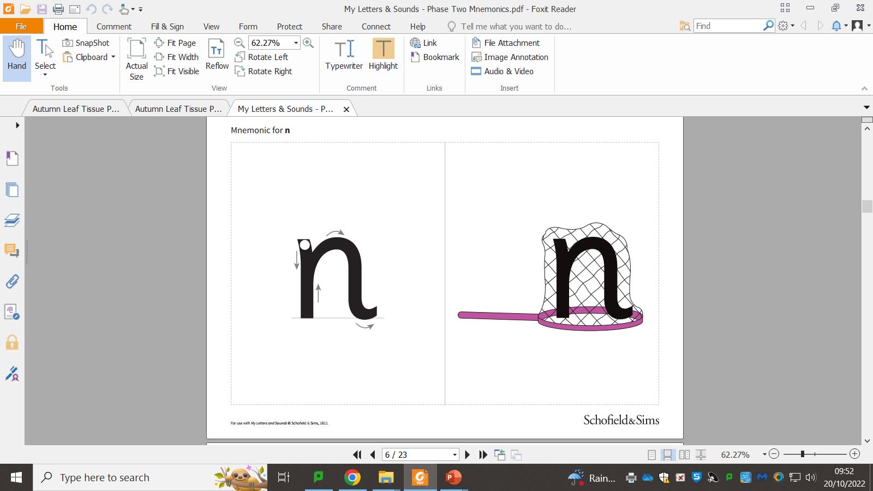

Slide 8
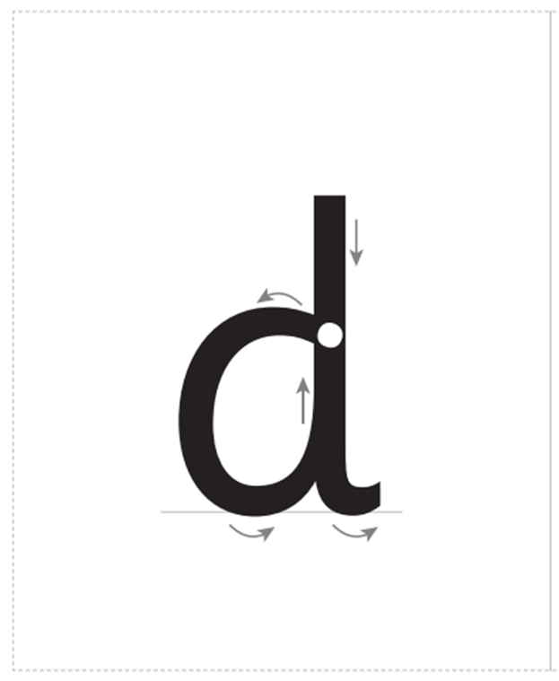

Slide 9


