Slide 1
My Letters and Sounds
Phase 2
Week 3
g o c k

Slide 2

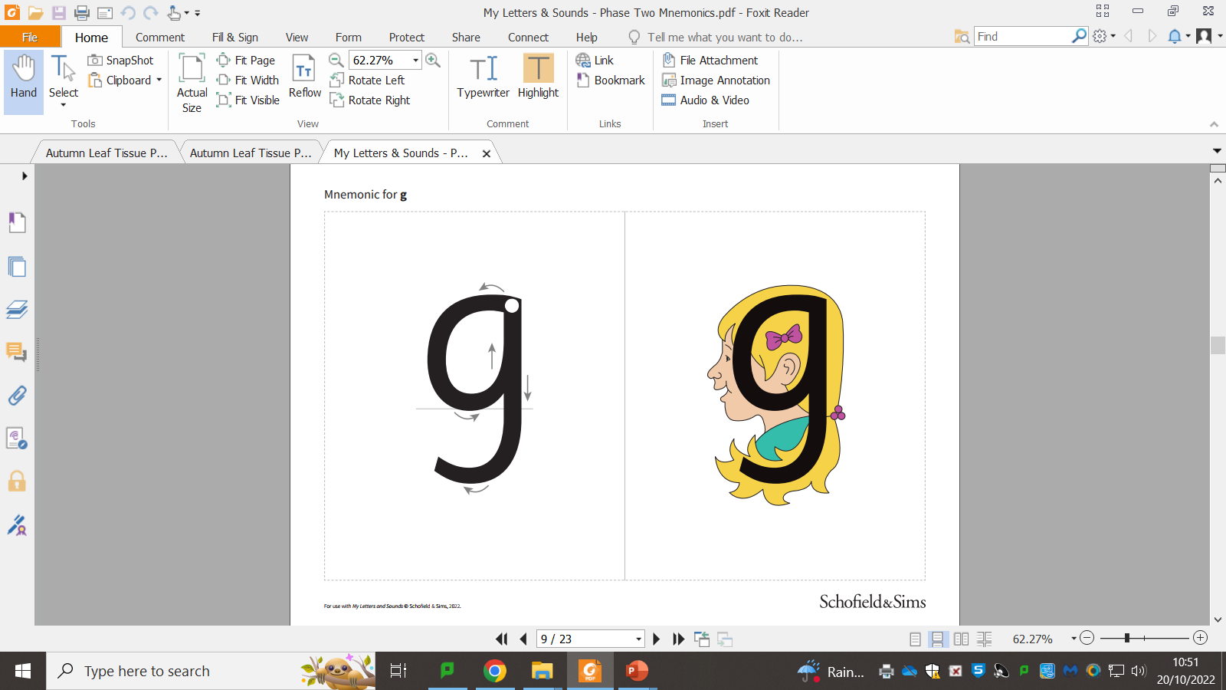

Slide 4
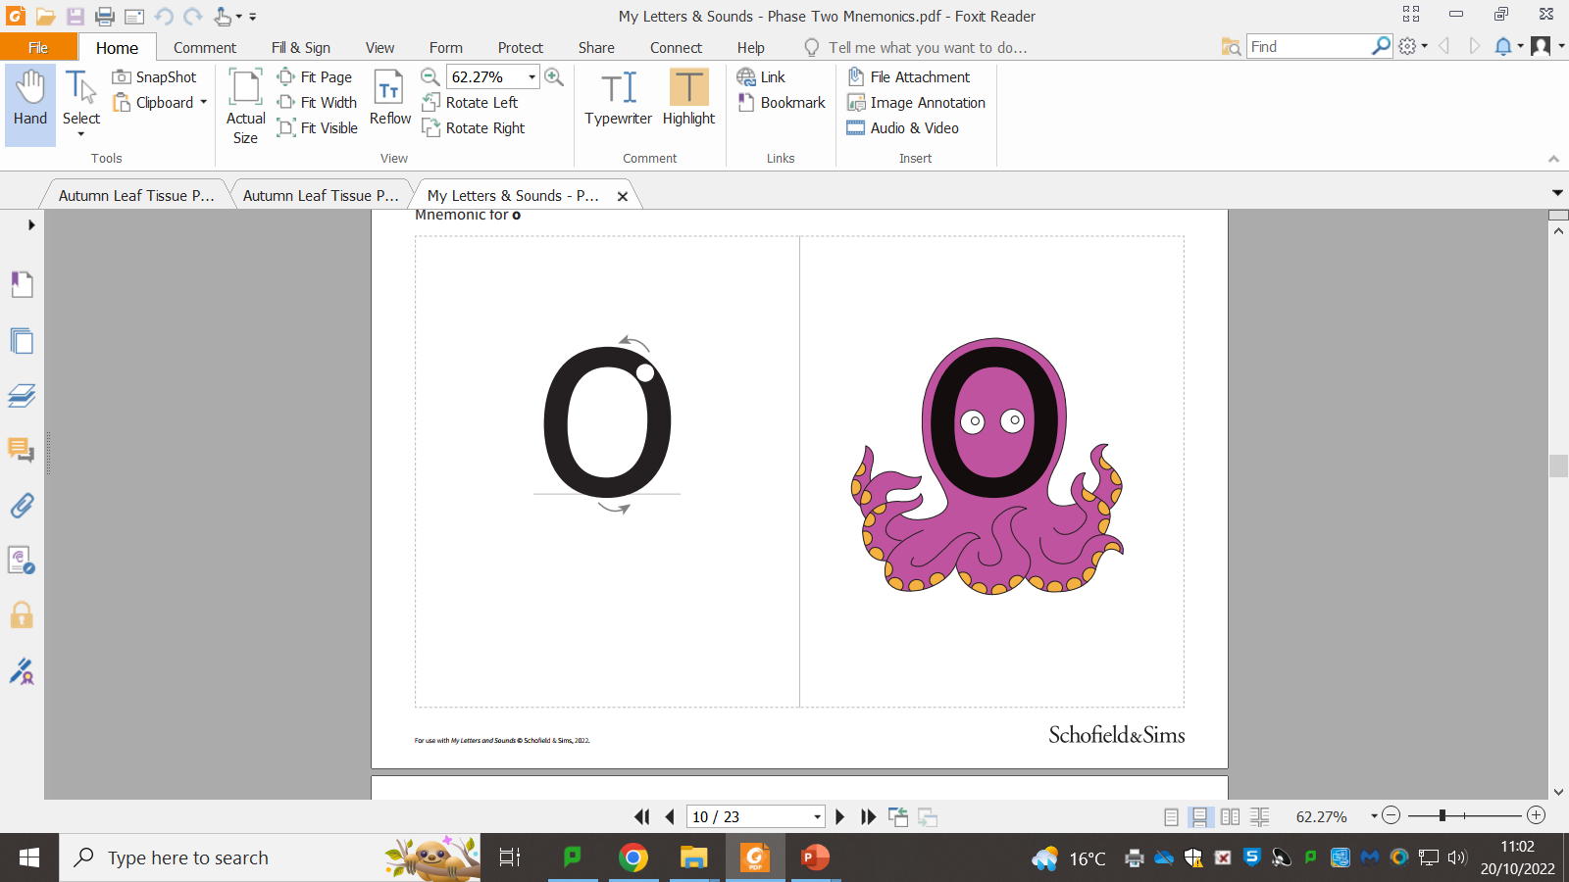

Slide 6
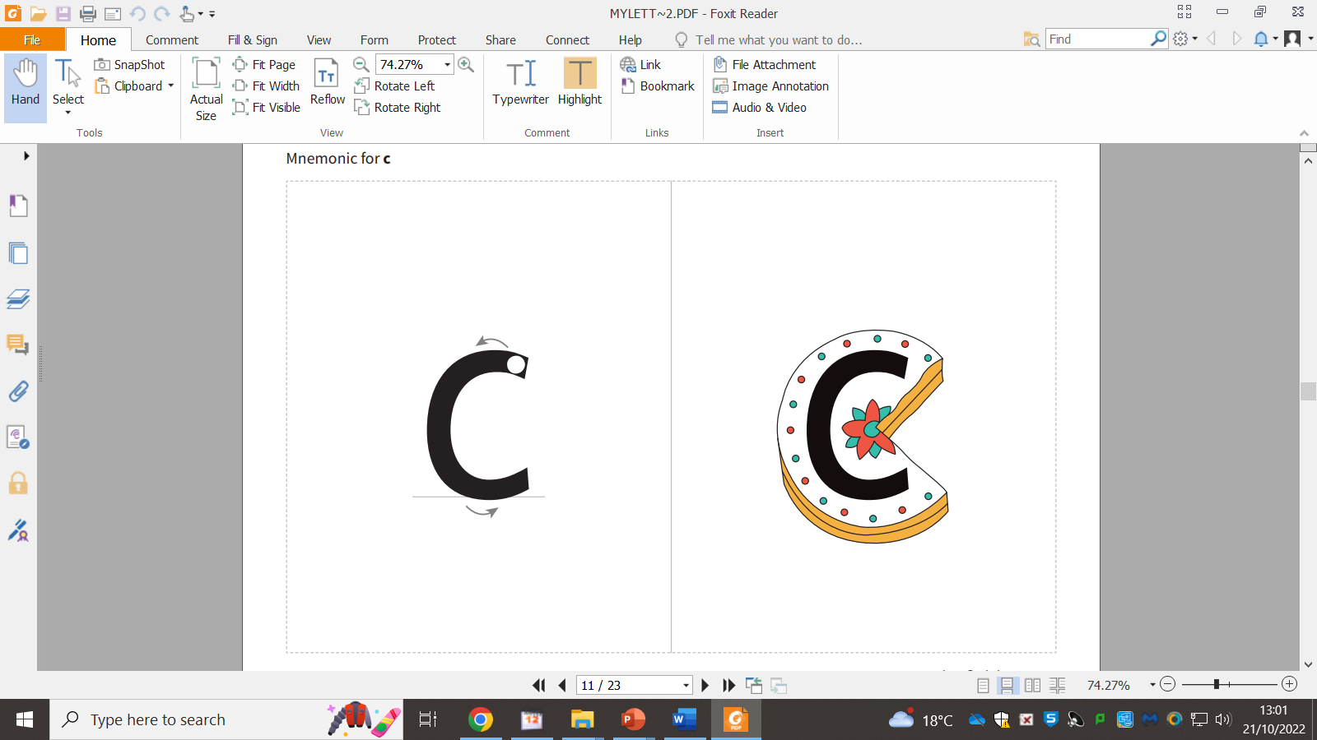

Slide 8


