Slide 1
My Letters and Sounds
Phase 2
Week 4
ck e u r

Slide 2

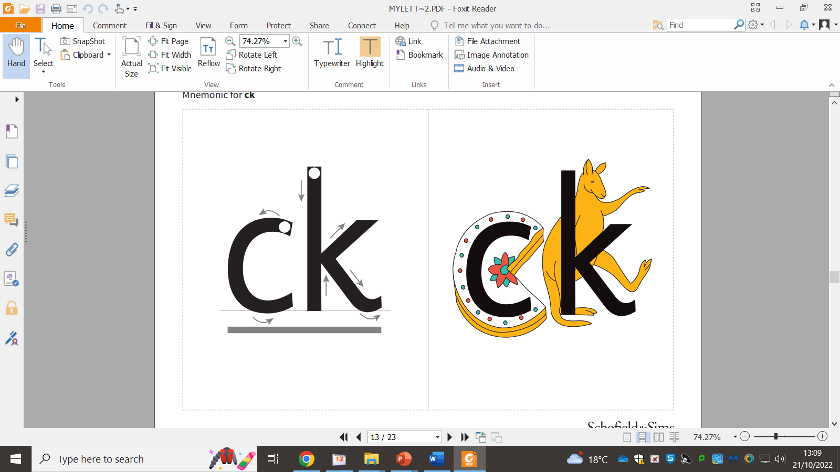

Slide 4
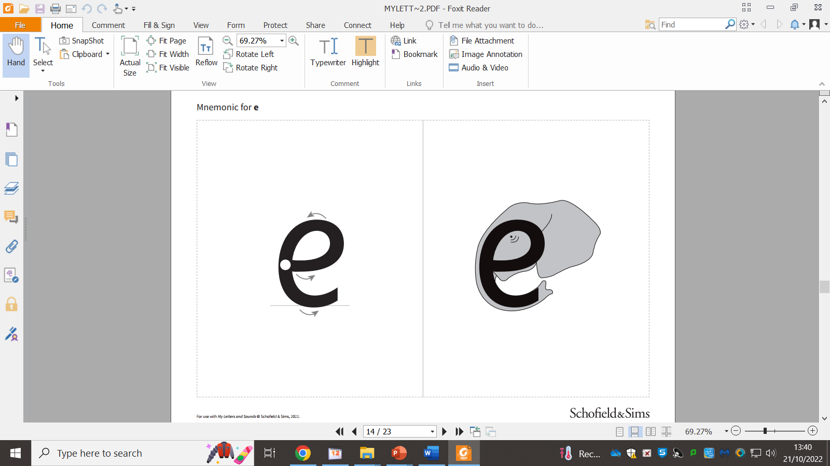

Slide 6
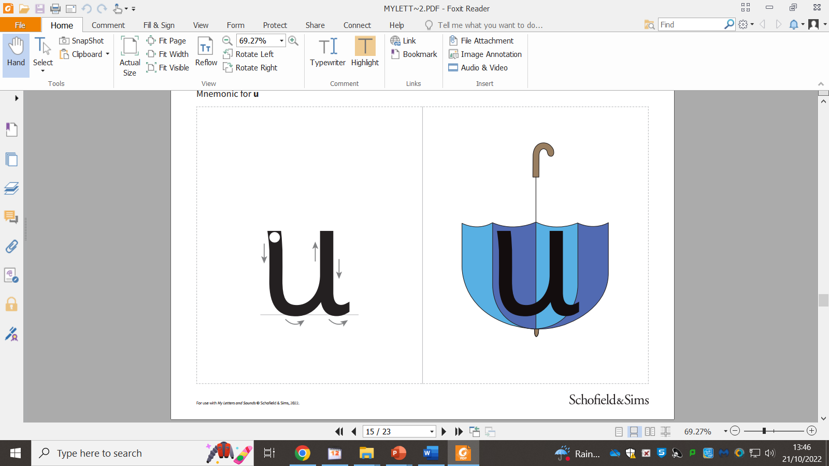

Slide 8


