Slide 1
Week 5
My Letters and Sounds
Phase 2
h b f ff l ll
Week 6: ss

Slide 2
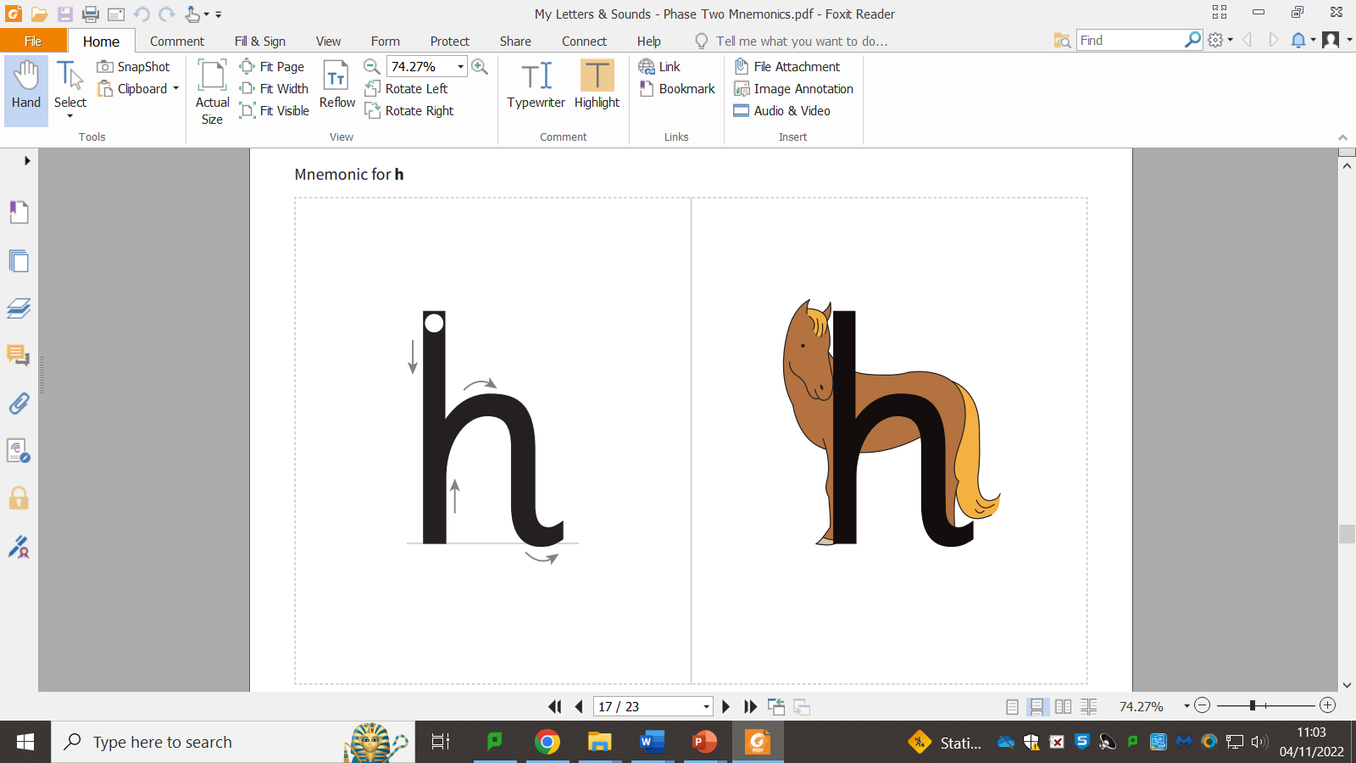


Slide 4
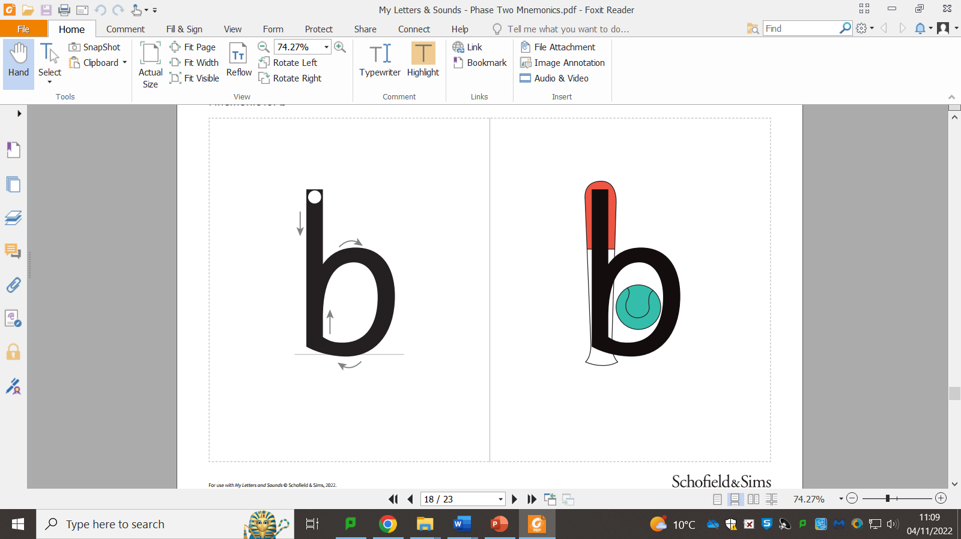

Slide 6
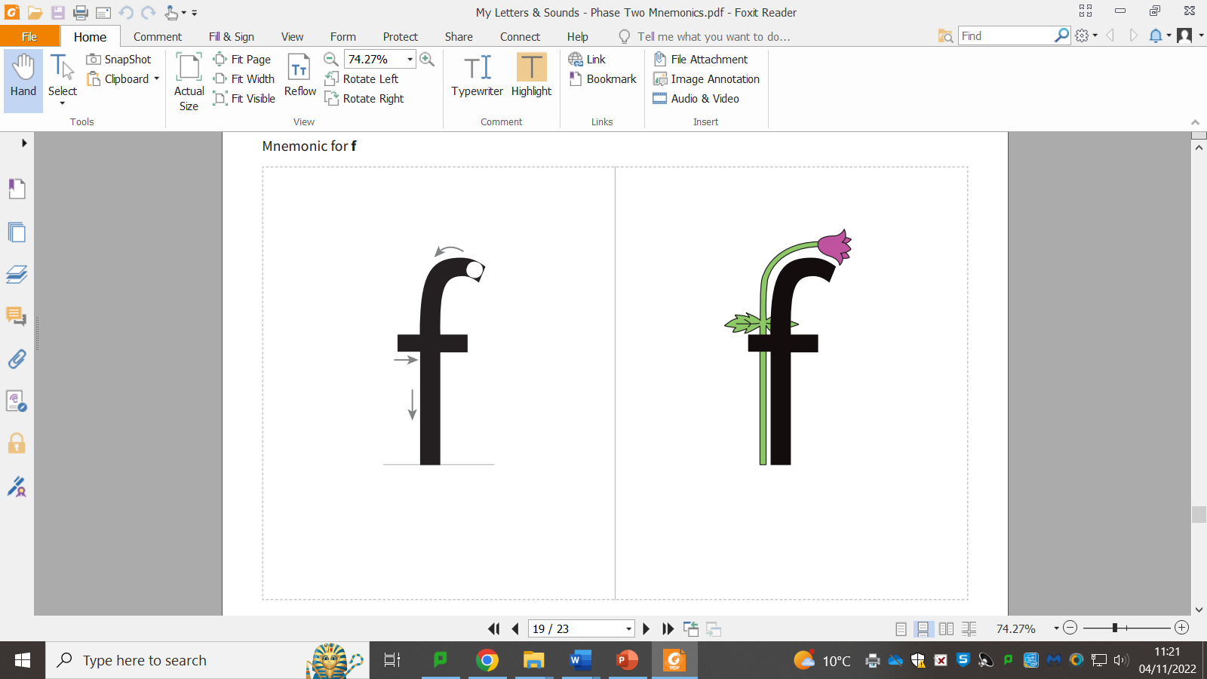

Slide 8
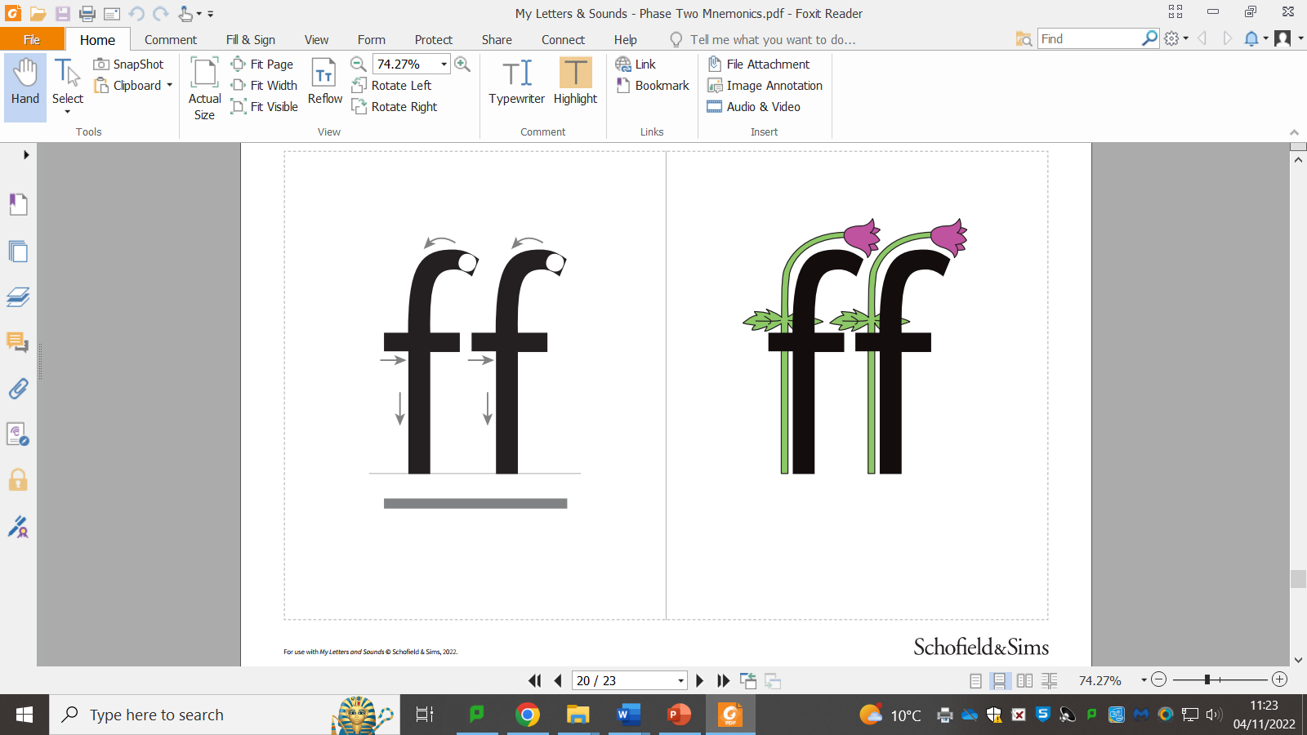

Slide 10
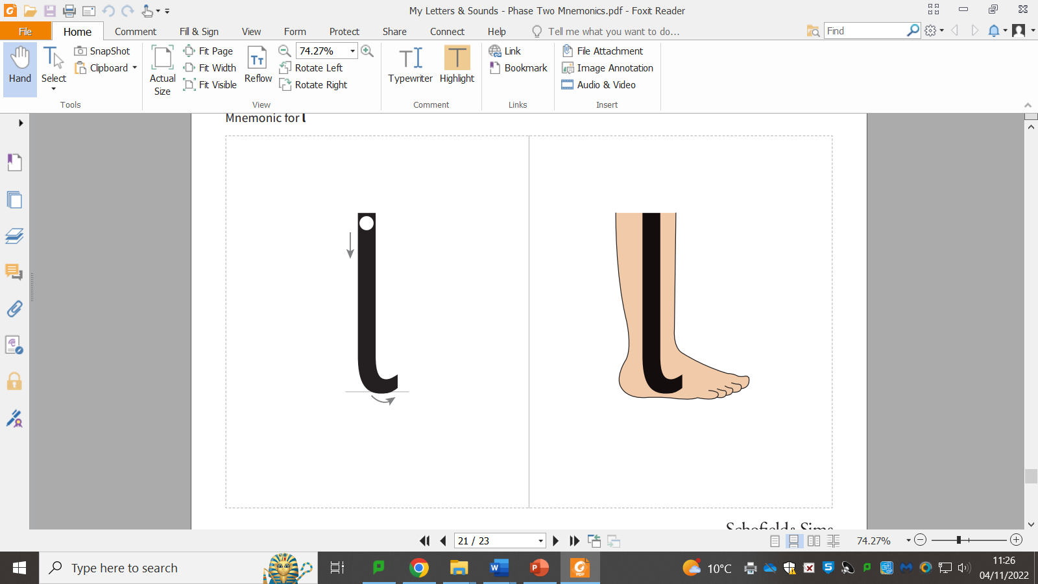

Slide 12
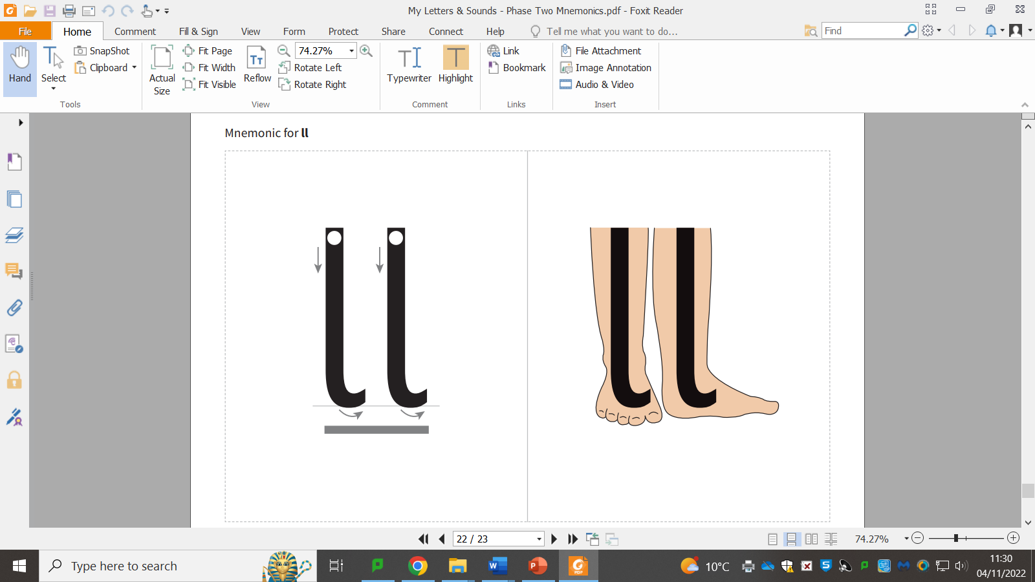

Slide 14


