Slide 1
My Letters and Sounds
Phase 3
Week 4
ai ee igh oa

Slide 2

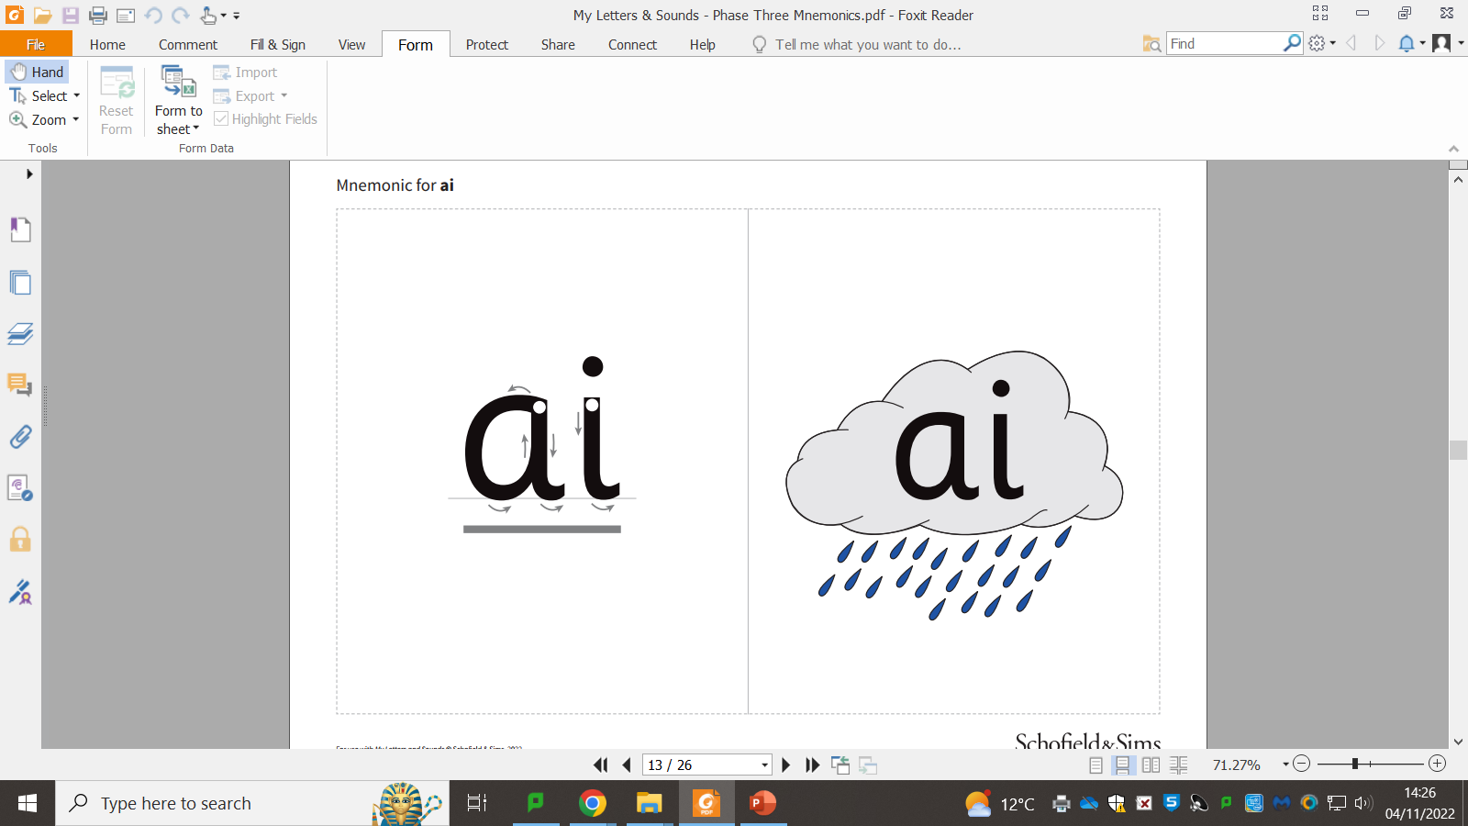

Slide 4
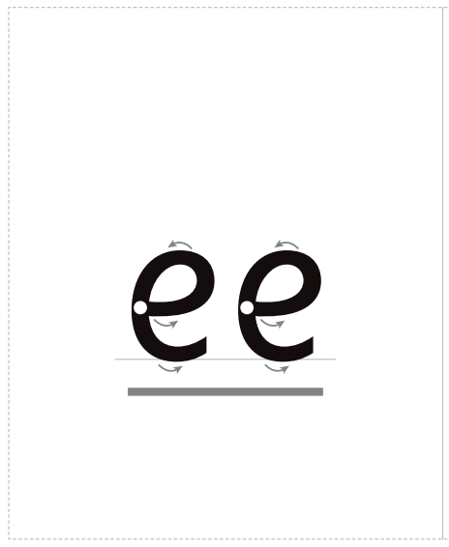

Slide 5
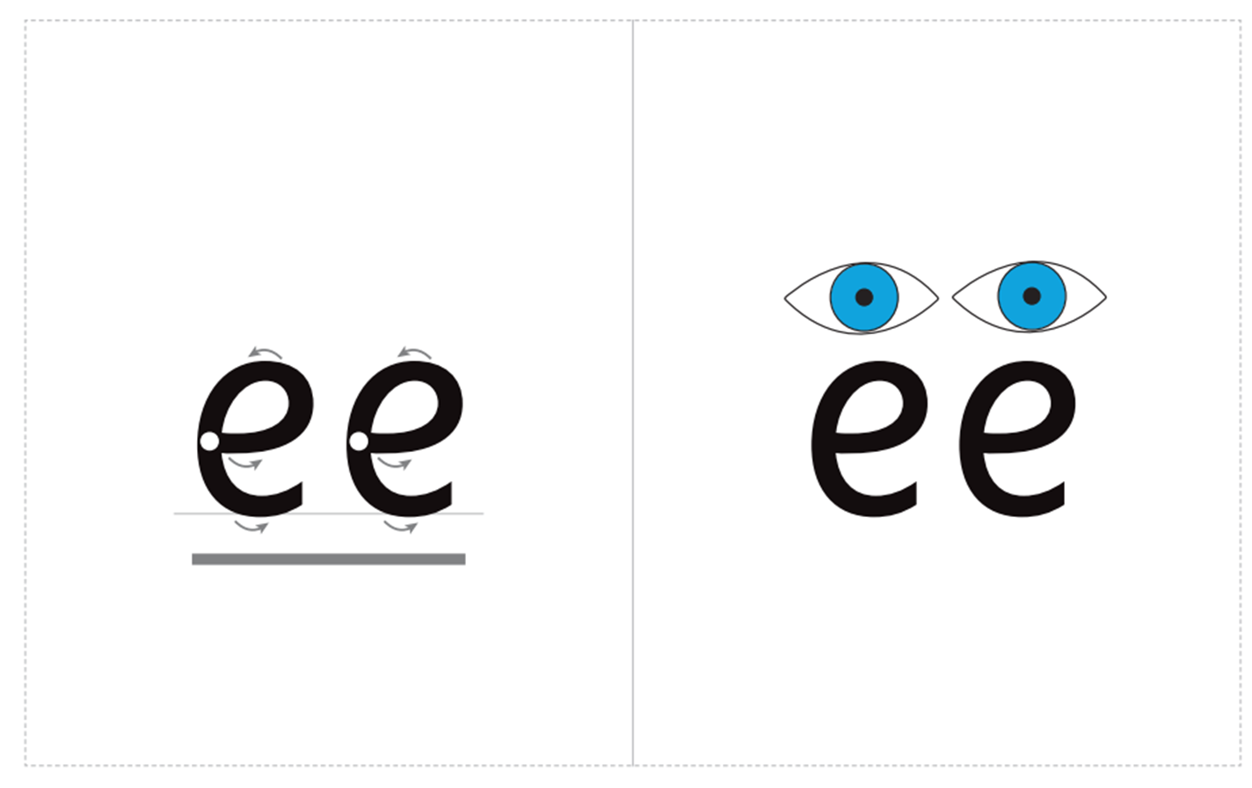

Slide 6
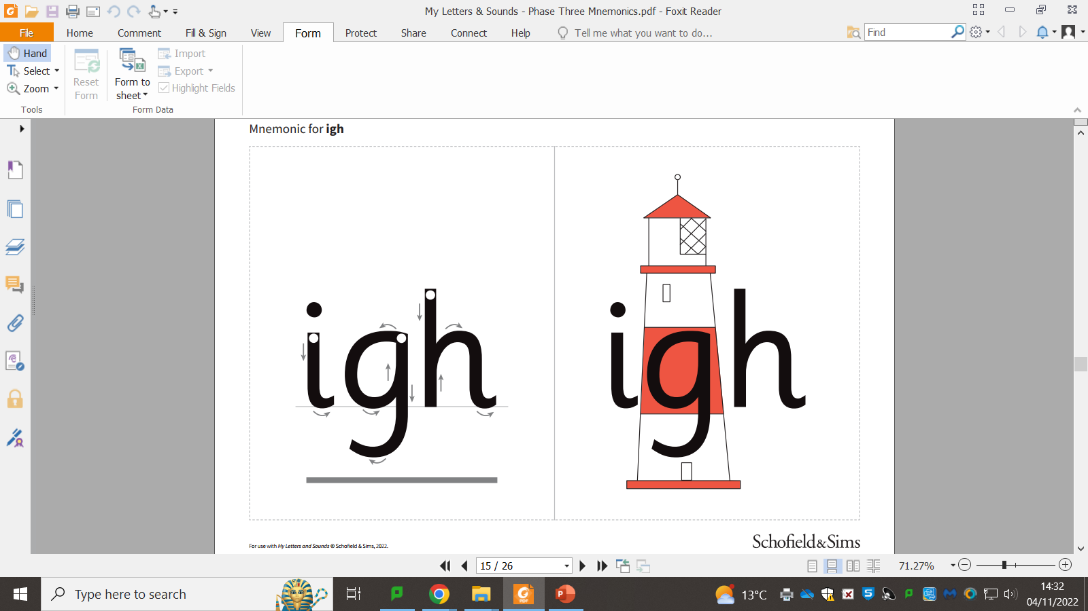

Slide 8


