Slide 1
My Letters and Sounds
Phase 3
Week 5
oo (long) oo
(short) ar or

Slide 2

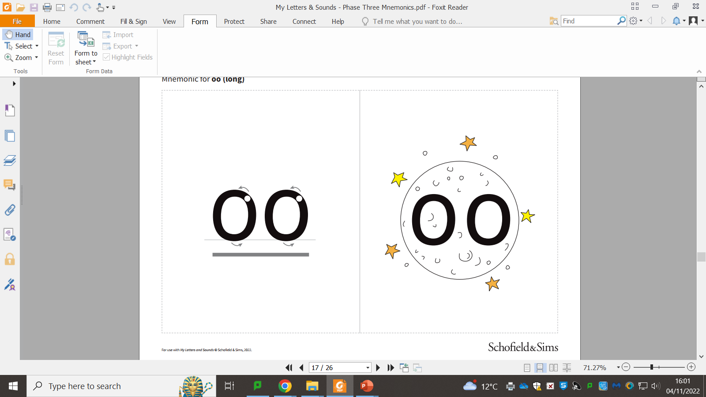

Slide 4
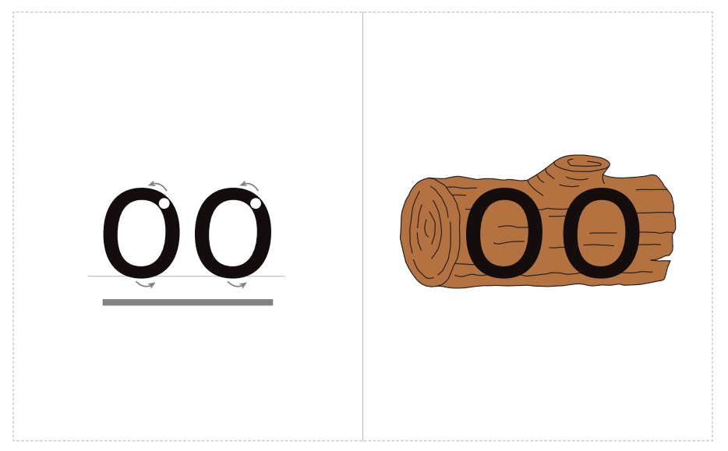

Slide 6
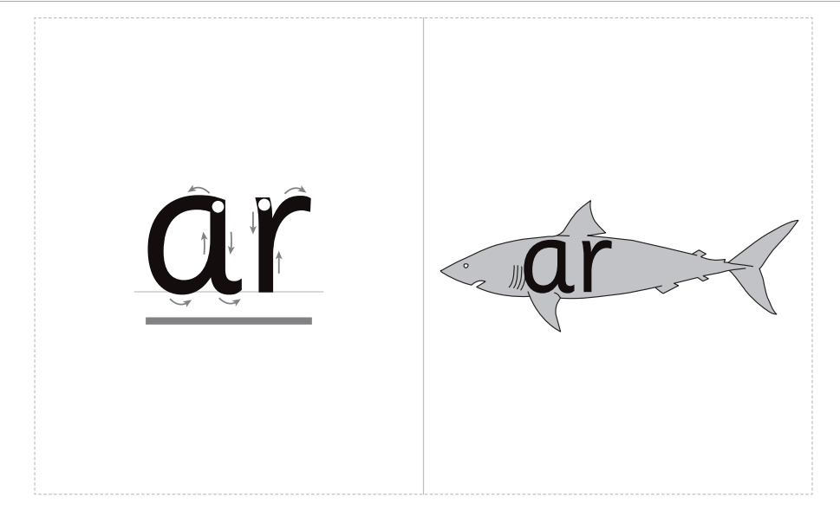

Slide 8


