Slide 1
My Letters and Sounds
Phase 3
Week 6
ur ow oi

Slide 2

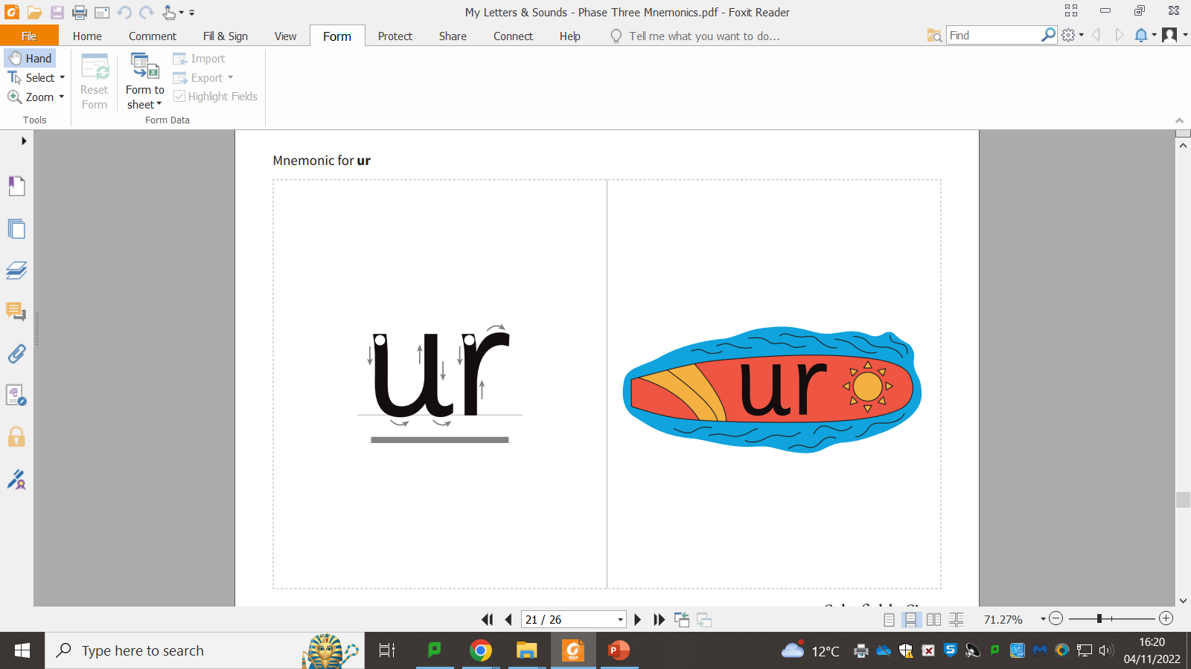

Slide 4
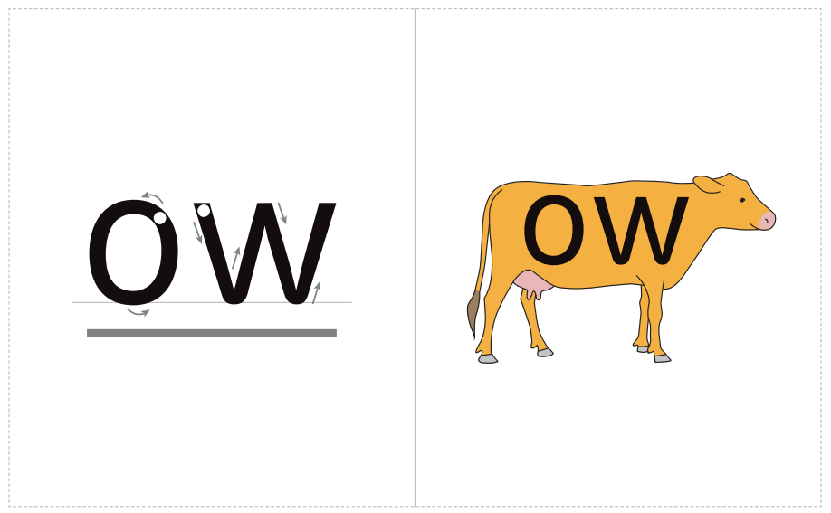

Slide 6


