Slide 1
My Letters and Sounds
Phase 3
Week 3
sh ch th ng

Slide 2

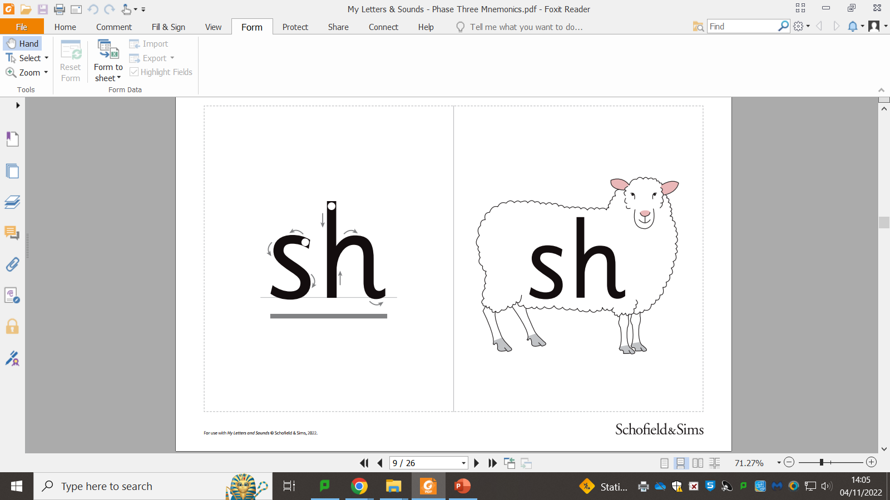

Slide 4
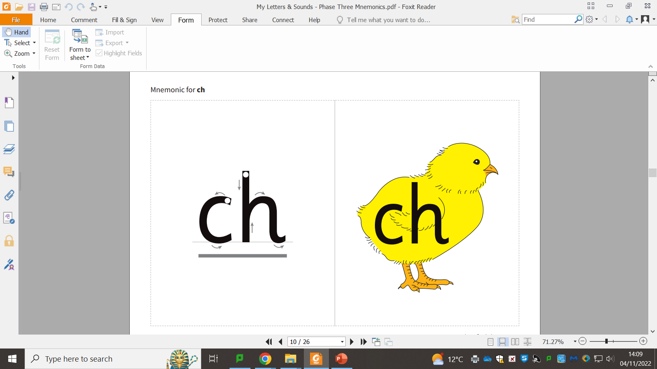

Slide 6
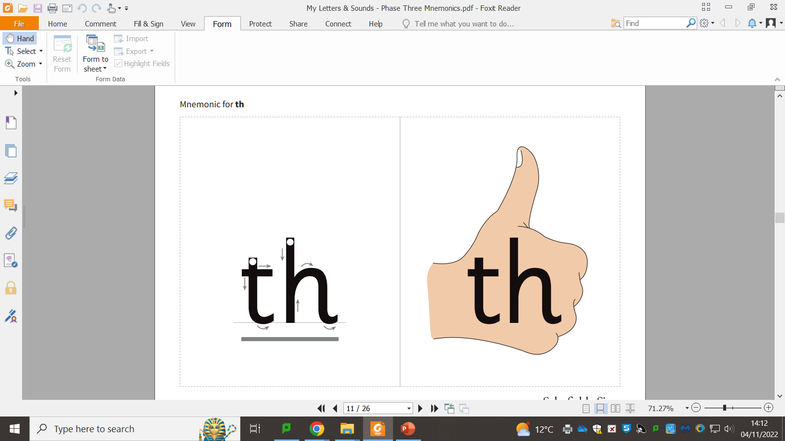

Slide 8


