Slide 1
Becontree Primary School
West ham united football club

Slide 2
Introduction
1. What happens when you work hard?
3. Jamie Johnson
4. Competition

Slide 3
Jamie Johnson
Jamie is a character from a series of books written by Dan Freedman.
Jamie Johnson is a 14 year old boy who loves to play football.
He is very talented but people do not always see how he is!

Slide 4
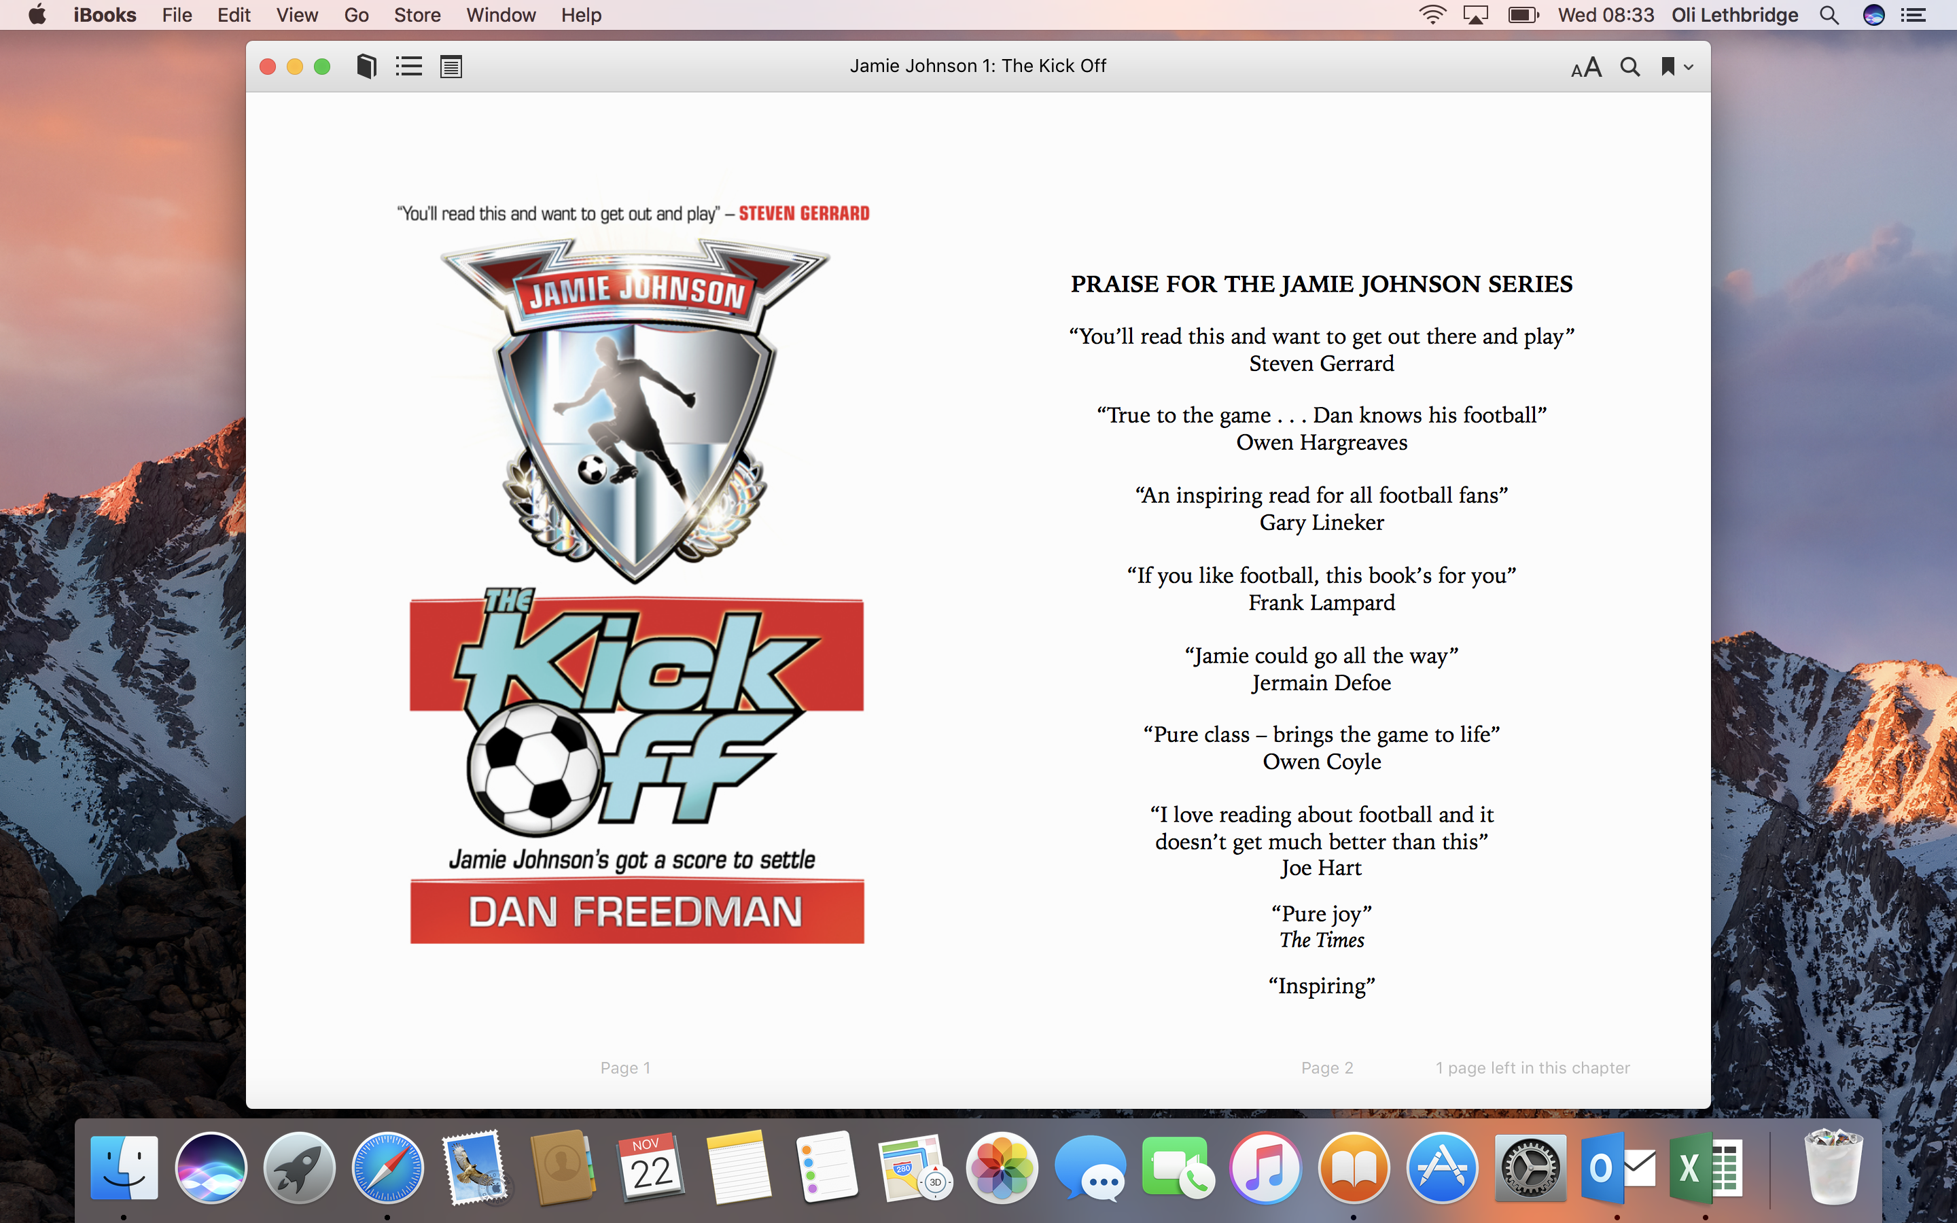
‘The Kick Off’ by Dan Freedman
This was it. This was Jamie’s chance to prove himself. This was what he’d waited six months for. Kingfield School didn’t know who Jamie Johnson really was. They didn’t know the kind of talent he had.
Now he could show them.
Dillon Simmonds had no idea who he’d been messing with. Jamie could shove all his stupid words back down his big, fat, spotty mouth with one goal today.

Slide 5
‘The Kick Off’ by Dan Freedman
That was the plan anyway. But these trials to see who would be in the Kingfield Under-fourteen A team next year were not going according to the script.
When he most needed his skills, nothing was working for Jamie. There were only ten minutes left and Jamie hadn’t shown a thing.
People kept hoofing the ball to him in the air. He was never going to get anywhere like that. He was a winger. He needed the ball passed to his feet.

Slide 6
‘The Kick Off’ by Dan Freedman
Jamie had been in pain since the first minute, too. He was wearing a pair of worn-out old socks that had holes in them and his boots were rubbing against his heels the whole time. He’d scored some of his best ever goals in these boots, but today they were hurting him. He was sure he was bleeding.
Jamie bent down and undid his laces. Maybe if he re-tied them looser it wouldn’t hurt as much.

Slide 7
‘The Kick Off’ by Dan Freedman
He had just done up his laces and was getting ready to stand up and get back into the game when he suddenly felt a knee jar right into his ribs. It knocked him sideways on to the ground.
“Oi, Ginger Minger- what you doing on the floor? Had enough, have you?” sneered Dillon Simmonds as he jogged past. They both knew full well that it was him who’d knocked Jamie over, and that he’d done it on purpose. You could see it in his evil smile.

Slide 8
‘The Kick Off’ by Dan Freedman
“Shut your face, Simmonds- you fat numpty,” said Jamie, getting to his feet.
Jamie knew that Dillon wasn’t really fat. He was pretty much all muscle. But he also knew that Dillon hated being called fat so it was a good way to wind him up.
“Talk to me when you’ve actually touched the ball, Ginge,” Dillon shouted back, laughing as he went.

Slide 9
‘The Kick Off’ by Dan Freedman
Jamie jogged back to this position on the left wing. He was shaking his head. The sad thing was, for once in his life Dillon actually had a point. Jamie had hardly touched the ball all game and he knew it. Mr. Marsden probably didn’t even know he was on the pitch.
But then, out of nothing, it happened. A chance!
The goalkeeper on Jamie’s side belted the ball forward. It was a huge kick and when it hit the hard dusty ground, it bounced so high that it went over the whole of the defence.

Slide 10
‘The Kick Off’ by Dan Freedman
Jamie spotted what was going to happen before anyone else on the pitch. He dashed after the ball and was way too quick for any of the defender to keep up with him.
It was just him against the keeper. He was in.
Latching on to the ball, he steadied himself as he waited for it to drop.
One sweet strike from his left foot. Then Marsden would know who Jamie Johnson was, all right.

Slide 11
Questions
How do you think Jamie is feeling when he has been tripped over by Simmonds?
How should he react when Simmonds trips him over?
How do you think Jamie is feeling when he sees the ball coming towards him.

Slide 12
Competition
Challenge: To write the next chapter of ‘The Kick Off’.
The competition finishes on Friday 1st of
December.
It must have at least three paragraphs
and should try to follow up on the story so far.

Slide 13
Thinking Points
Is Jamie going to score the goal or is something else going to happen?
What happens after the game?
How might some of the characters be feeling?

