Slide 1


Slide 2
At Becontree, we focus on 4 main Growth Mindset areas
Curiosity
Improvement
Persevering
Co-operation

Slide 3
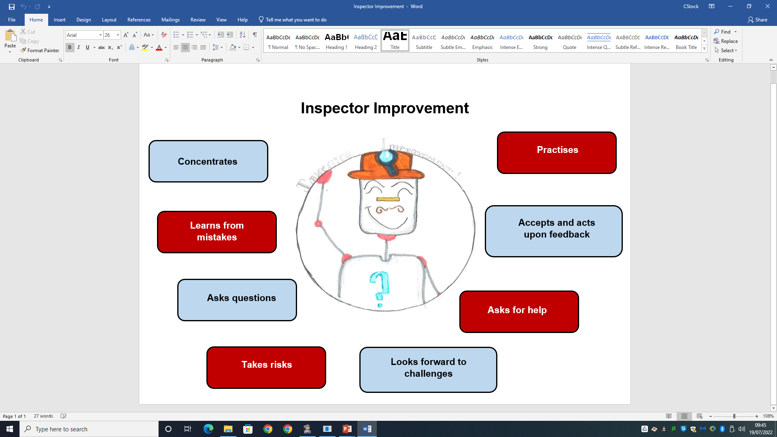
Growth Mindset winners this week have been chosen for:
…showing the character traits of Inspector Improvement

Slide 4

Who are our Growth Mindset winners this term?

Slide 5
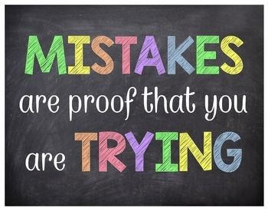
These children in RA have been chosen because they have demonstrated a Growth Mindset like…
Aliyaan
Adam H
Adelina
Aila
Amal
Hashim
Chloe
Jack

Slide 6
These children in RH have been chosen because they have demonstrated a Growth Mindset like…
Adeen | Sultan
Luna | Abdurrahman
Kaja | Harleen
Sofiia | Toby
Ismaeel | Sufyan
Alizah | Rayyan
Sabrina | Taylor
Makaya
Christian
Rukyat
Anna
Amanah
Shoaib

Slide 7
These children in 1D have been chosen because they have demonstrated a Growth Mindset like…
Thadina | Bushra
Aneesah | Michal
Salman | Spencer
Lia- Mae | Nahyan
Aiden | Ilinca
Isabella | Maia
Zaraan | Cris
Simrat | Henry
Fechi
Yusuf
Leana
Jaylen
Leah

Slide 8
These children in 1L have been chosen because they have demonstrated a Growth Mindset like…
Gracee Cranmer | Zain Muhammad
Julian Dunisha | John Page
Bella-Rose Cummins | Kaiser Quddus
Joy Ehimare | Zoya Rahman
Fiza Faruki | Jessica Toma
Anshara Habib | Aaminah Uddin
Amelia-Mae Hill | Lorenzo Rodrigues Pereira Vieira
Ivy-Mae Hopkins | Behram Waheed
Amrit Kaur | Matei Vanca
Evelyn Kaur | Muhammad Ikram
Ayra Khaleq Akter | Sofia Young
Zunairah Laiq | Abdullah Javed
Zion Malaescu

Slide 9
These children in 2G have been chosen because they have demonstrated a Growth Mindset like…
Anshika | Musa
Aranya | Nawwar
Ayaat | Nyla
Aleeza | Rhys
Buna | Rory
Emily | Uzair
Gurfateh | Yaqoob
Nazifa | Zahra
Isaac
Jessica
Joy
Kasandra
Lexi- Mae

Slide 10
These children in 2D have been chosen because they have demonstrated a Growth Mindset like…
Enis | Layla
Mayeda | Umar
Khadeeja | Sydney
Mikael | Sara
Dollie | A.J.
Cristian | Daria
Damir | Zayn
Lily-May | Rhea
Chloe | Rida
Shay | Malcom
Indie
Ayaan
Ashmeet

Slide 11

Who will be celebrating next ½ term?

