Slide 1


Slide 2
At Becontree, we focus on 4 main Growth Mindset areas
Curiosity
Improvement
Persevering
Co-operation

Slide 3
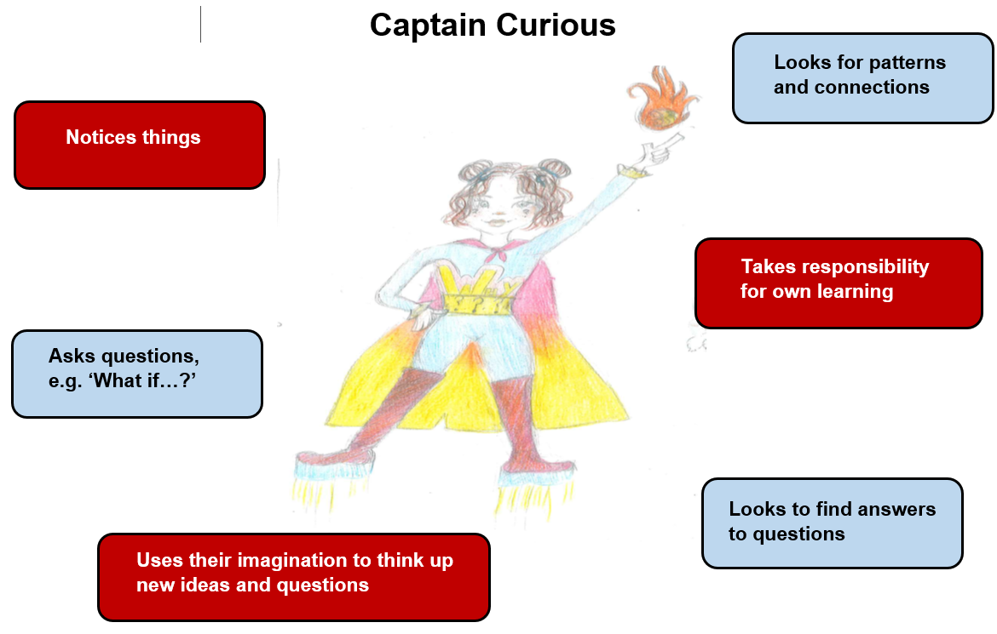
Growth Mindset winners this week have been chosen for:
…showing the character traits of Captain Curious

Slide 4

Who are our Growth Mindset winners this term?

Slide 5
These children in RA have been chosen because they have demonstrated a Growth Mindset like…
Amal
Adam K
Adam H
Vjosa
Hashim
Veer
Adelina
Nafay
Ahmed
Bahiya
Freya

Slide 6
These children in RH have been chosen because they have demonstrated a Growth Mindset like…

Slide 7
These children in 1D have been chosen because they have demonstrated a Growth Mindset like…
Thadina | Leana
Aneesah | Faozat
Aiden
Isabella
Zaraan
Simrat
Fechi
Yusuf
Cris
Lia-Mae
Leah
Bushra
Henry

Slide 8
These children in 1L have been chosen because they have demonstrated a Growth Mindset like…
Antonio | Aaminah
Gracee | Lorenzo
Bella-Rose | Behram
Joy | Matei
Fiza | Muhammad
David
Amelia
Ivy
Amrit
Evelyn
Nicholas
Kaiser
Jessica

Slide 9
These children in 2G have been chosen because they have demonstrated a Growth Mindset like…

Slide 10
These children in 2D have been chosen because they have demonstrated a Growth Mindset like…
Enis | Layla
Mayeda | Umar
Khadeeja | Sydney
Mikael | Sara
Dollie | A.J.
Cristian | Daria
Damir | Zayn
Lily-May | Rhea
Chloe | Rida
Shay | Logan
Indie | Malcolm
Ayaan
Ashmeet

Slide 11

Who will be celebrating next ½ term?

