Slide 1


Slide 2
At Becontree, we focus on 4 main Growth Mindset areas
Curiosity
Improvement
Persevering
Co-operation

Slide 3
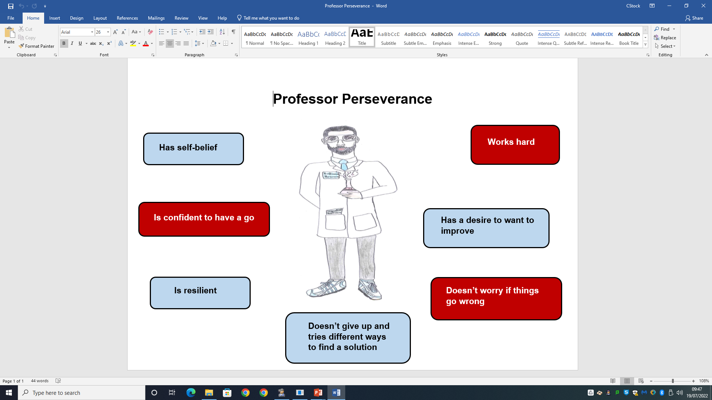
Growth Mindset winners this week have been chosen for:
…showing the character traits of Professor Perseverance

Slide 4

Who are our Growth Mindset winners this term?

Slide 5
These children in RA have been chosen because they have demonstrated a Growth Mindset like…
Simon
Esa
Ashmira
Kyrie
Rachel
Veer
Jack
Nimrat
Ajlan
Freya

Slide 6
These children in RH have been chosen because they have demonstrated a Growth Mindset like…
Adeen
JJ
Hooriya
Rayyan
Lucas
Makaya
Anna
Srijit
Toby
Sofiia
Shoaib
Abdurrahman
Luna

Slide 7
These children in 1D have been chosen because they have demonstrated a Growth Mindset like…
Thadina | Ilinca
Aneesah | Nahyan
Frankie | Spencer
Salman | Bushra
Jaylen | Leah
Aiden | Fatimah
Isabella
Zaraan
Simrat
Faozat
Leana
Tegbeer

Slide 8
These children in 1L have been chosen because they have demonstrated a Growth Mindset like…
Antonio | Aaminah
Bella-Rose | Kaiser
Julian | John
Joy | Rejoice
Fiza
Abdullah
Amelia
David
Amrit
Evelyn
Ayra
Muhammad
Matei

Slide 9
These children in 2G have been chosen because they have demonstrated a Growth Mindset like…
Anshika | Kasandra
Aranya | Lexi-Mae
Ayaat | Maryam
Ayyan | Musa
Aleeza | Nawwar
Buna | Nyla
Emily | Rhys
Gurfateh | Rory
Nazifa | Uzair
Ibrahim | Zahra
Isaac | Zion
Jessica
Joy

Slide 10
These children in 2D have been chosen because they have demonstrated a Growth Mindset like…
Enis Ademaj | Daria Pereman
Khadeeja Ali | Zayn Qureshi
Mikael Ali | Rhea Solanki
Cristian Bujdei | Rida Syeda
Damir Ciobanu | Logan Tucker
Lily-May Cummings | Malcolm Da Costa Fernandes
Chloe Gallagher
Shay Gallagher
Ashmeet Kaur
Umar Khan
Sydney Lamerton
Sara Markou
A.J. Mugenyi

Slide 11

Who will be celebrating next ½ term?

