Slide 1

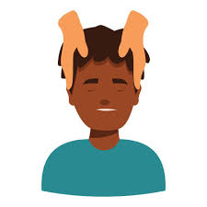
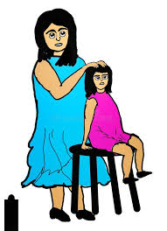


FREE WORKSHOPS FOR YEARS 3-6
We are holding two workshops for families and children in
Years 3, 4 5 & 6
INDIAN HEAD MASSAGE
WEDNESDAY 5TH FEBRUARY AT 9.15 AM
An expert from the adult college will come in and teach you how Indian Massages can help to relieve stress and you will be given key tips on how to do this yourself.
STAY CALM DURING ASSESSMENTS
TUESDAY 11TH FEBRUARY AT 9.15 AM
In this workshop you will learn how to help your child cope with any stress they may be feeling in the run up assessment tests, SATs exams, moving into new year groups and even starting Secondary school. You will be given lots of tips to help support your child with this .
If you are interested in any or both of these workshops, please call the office and ask to speak to Jackie.
Thank you!
Strengthening the partnership between home and school

